Slide 1

Testing Overview
18/03/2021
Gabriel Ng
Nigel Charlton

Slide 2
Welcome!
Currently working with
Sharks (Statements)
Cobra (Repair & Returns)
Bear (FinCrime)
Across Domain - MCCY/FX and FinCrime
Joined last week
My role – Provide QA overall guidance, strategy with Dev Teams to steer, implement and align existing Test Architecture in ClearBank
Usually participate in stand-ups/refinements, occasionally planning/retro – alternate between teams

Slide 3
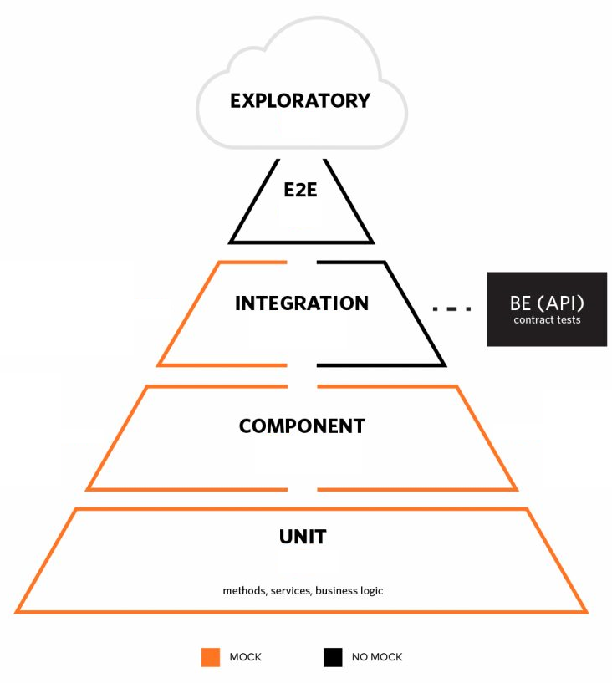
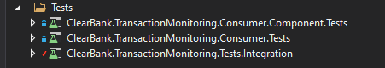
Test Pyramid
Lightweight, happy pass flow, negative flow, live proving, webhooks test
Tests to be run/interacting against deployed services/endpoint.
- For downstream systems/third party providers (Feature space, MCCY Wires) we would use emulators (Azure Release Pipeline)
In memory tests(sometimes referred to as Acceptance tests, Behavioural tests), covers what unit tests cant, but still runs in memory
ie: Validation as part of middleware, can’t unit test the middleware,
load up the service in memory and test against it; able to inject in mocked client to not rely on real downstream systems
- Some teams choose to have component tests over unit tests, team can decide which one would be more appropriate overall (Azure Build Pipeline)
Mocks out specific services, test methods/service, business logic

Slide 4
Shift Left, BDD Approach
General approach is to test early in the SDLC, promote shift-left testing to ensure better test coverage, scope for test automation
Dev team should always have testing mindset during refinement sessions when grooming PBIs, open discussion on how/what to tests, tools
All stories should be written in a way that should be testable (Follow agile INVEST approach)
Component/Integration/E2E tests should be written in BDD approach for BAs/Stakeholders/ Pos (Business) to understand and review functionality implemented to ensure requirements are met, PR/SRs reviews
Avoid creating tech debt for tests to be written after implementation
Test tasks to be created during planning sessions and take into consideration when story pointing
Test tools – (Existing teams/repos uses Specflow) Trying to move away and adopting BDTest https://github.com/thomhurst/BDTest, HTTP client, RestSharp
Code Coverage on build pipelines, must be over 80%, Cobertura being used in other teams
Occasions where manual testing is needed; ie: due to downstream systems/ UAT to ensure event has arrived from service bus, edge cases (use as last resort)
Start thinking about Performance Testing strateg => currently only for Market - Market/Stable/Scale business phases, MCCY currently in Market phase
https://dev.azure.com/cbinfrastructure/CBI%20Documents/_wiki/wikis/CBI-Documents.wiki/2988/Stages-Requirements
Going forward, to maintain any existing tests if any
Quick run through of FinCrime Repo
MCCY E2E tests (Nigel Demo, BDTest)

Slide 5
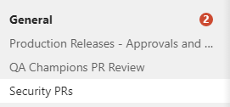
Pull Requests, Software Release (PR,SR)
PR – 4 Eyes: Dev on the team, QA/SDET, Security Champion (Teams Group PR groups)
SR – (Work items Azure Dev Ops) To go beyond staging to SIM etc, signed off by QA(PR count as 1) Domain (POs, Senior Tech Manager), Release Team
https://dev.azure.com/cbinfrastructure/cbi/_workitems/edit/155740
Agreement on who should take on role of the team’s QA Champion and security champion
PR Template
Deploy to test environment -> PR-> Merge -> Deploy to staging -> Load test (daily FinCrime, Sterling) -> SR -> Sim -> Prod

Slide 6
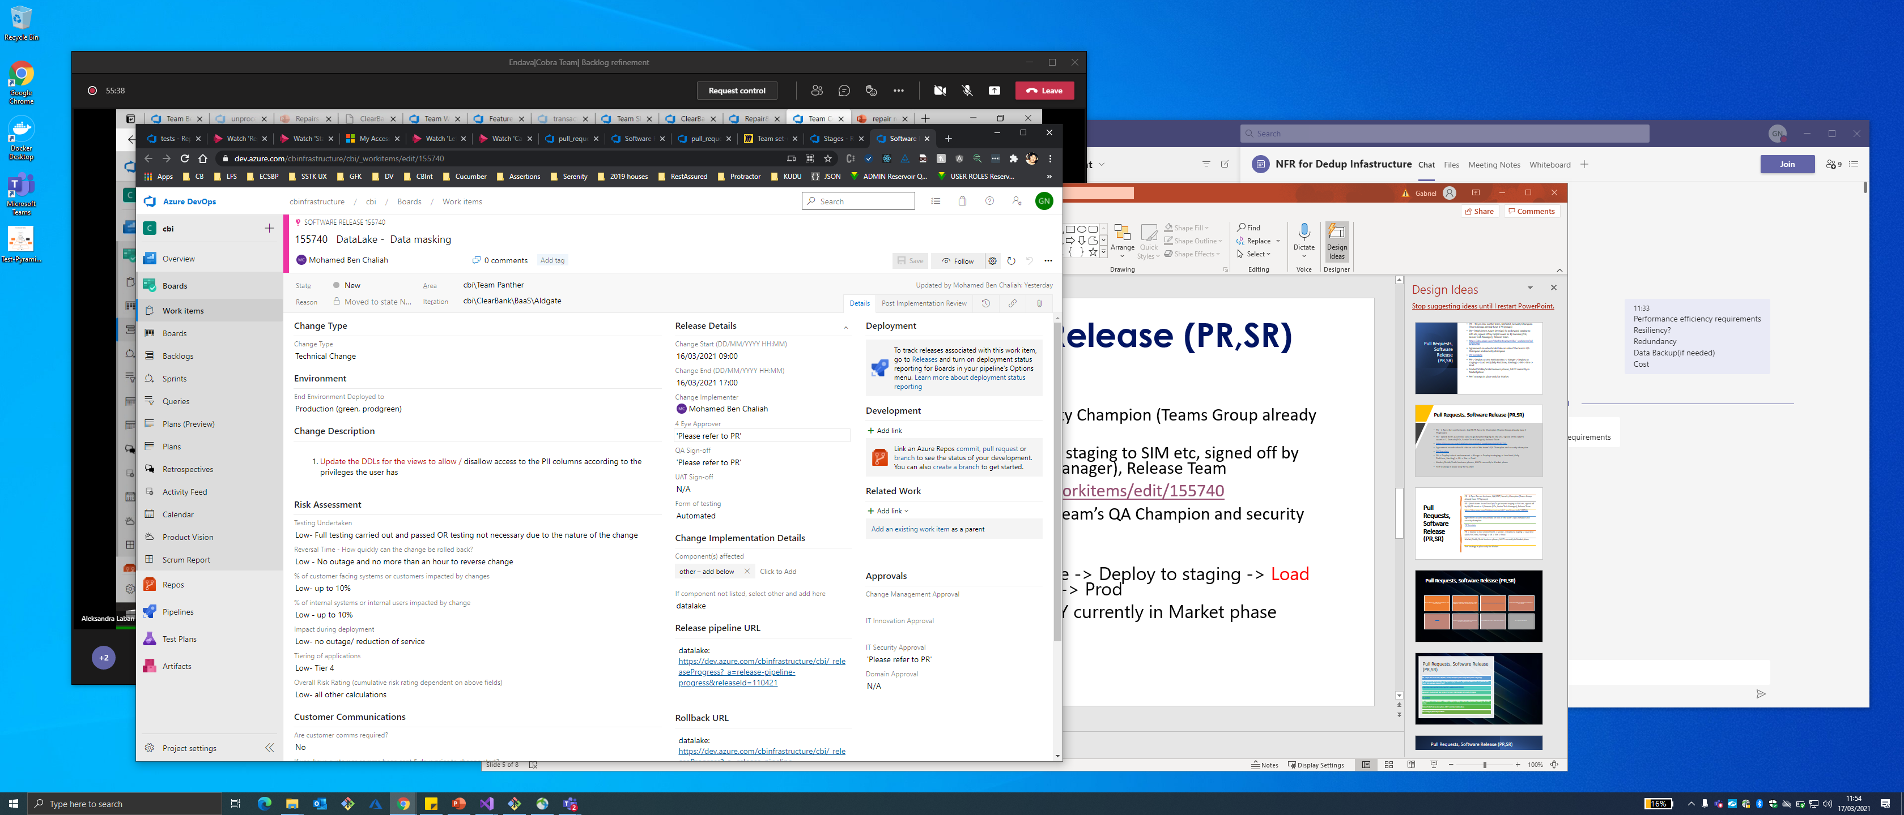
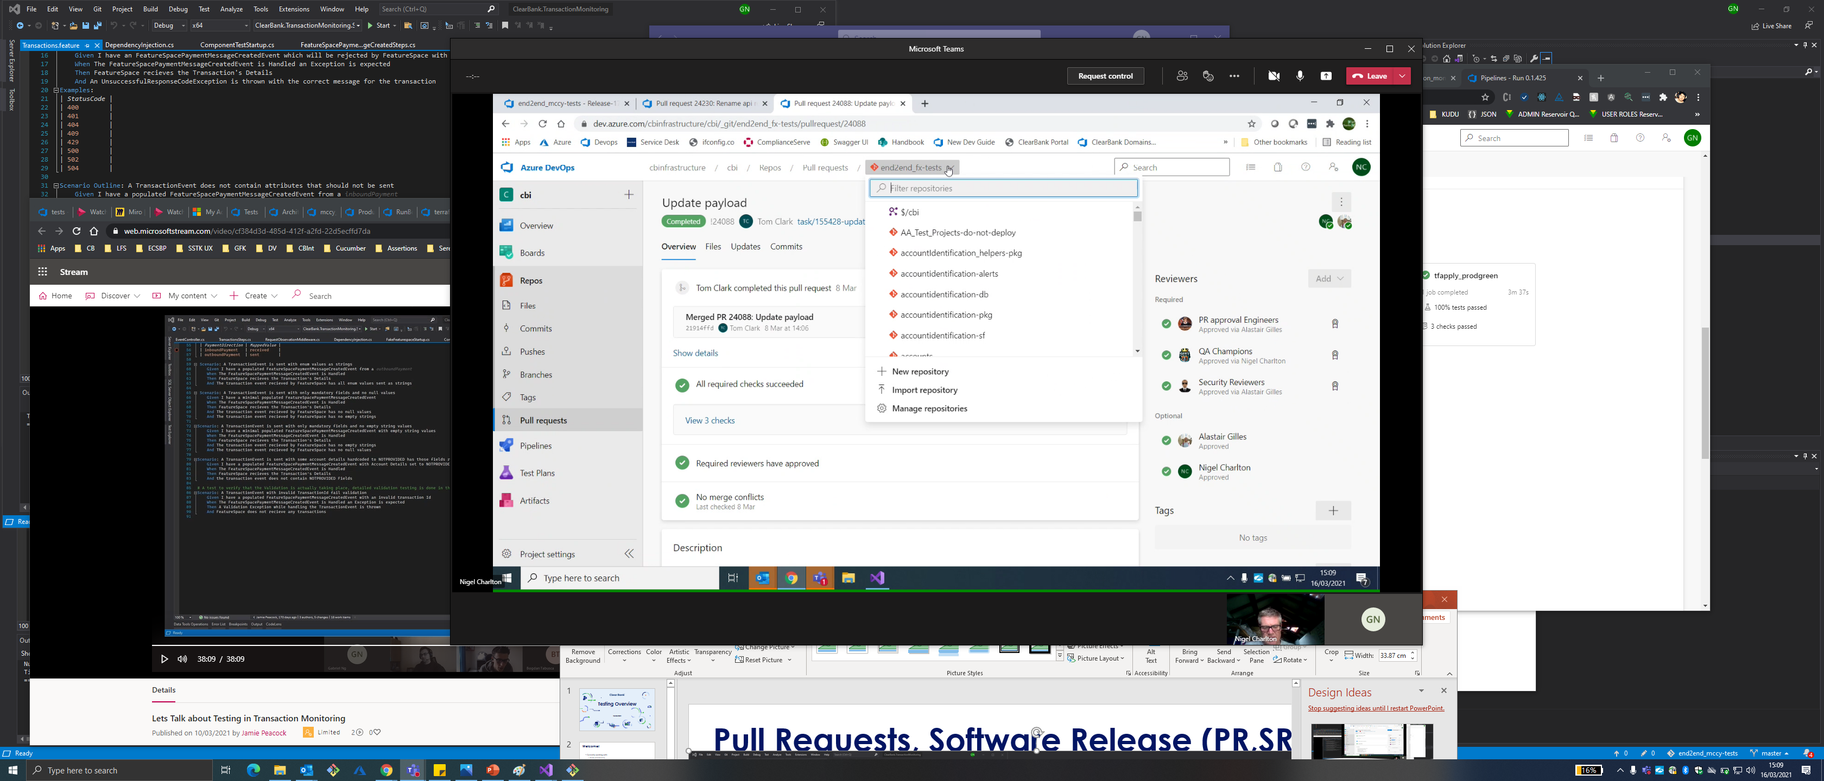
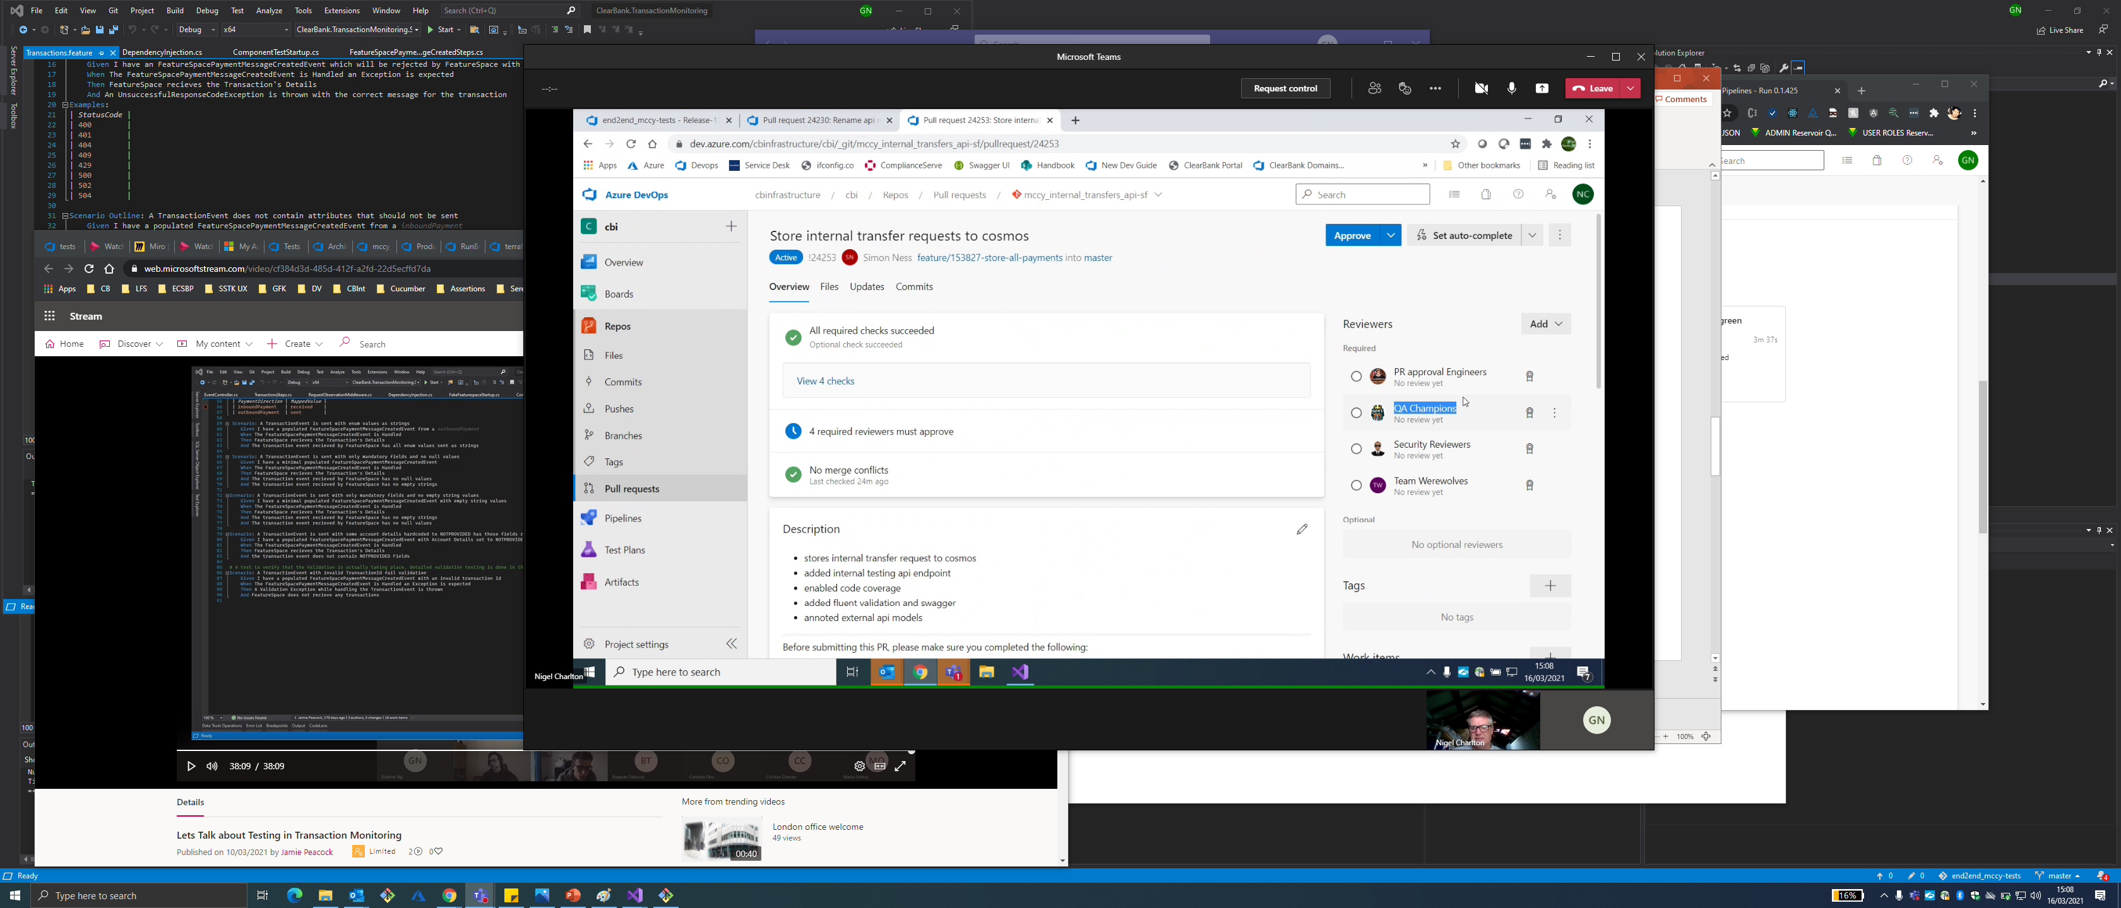
Pull Requests, Software Release (PR,SR)

Slide 7
Environments
Each Hives has their own environment, MCCY environment to be created going forward (currently its Test Lemur for MCCY)
Test, Staging, SIM, Prod
For SIM/Prod deployments, requires Dev’s team lead approval
Build Pipeline, Release Pipeline
https://dev.azure.com/cbinfrastructure/cbi/_build?pipelineNameFilter=transaction_monitoring
https://dev.azure.com/cbinfrastructure/cbi/_build/results?buildId=230148&view=results
V2 Yaml pipelines being used currently https://dev.azure.com/cbinfrastructure/cbi/_git/transaction_monitoring-sf?path=%2Fazure-pipelines-ci.yaml
TF pipeline runs first, follow by SF Build -> Release
Cut off time for SR deployments is 4pm UK GMT UK Time, daily
Demo of Azure Portal (Nigel)

